Slide 1
MIL/SIL/PIL/HIL Test Cases And Overview FlexRay
- Confidential -
13.10.2016

Slide 2
MiL (Model in the Loop):
Test object: model
Input signals are simulated
Output signal values will be saved/logged and can be compared to the expected values.
Automatic test execution through:
The development environment used for modeling.
External tools using the appropriate interface of the modeling environment (e.g: automation interface of MATLAB/Simulink).

Slide 3
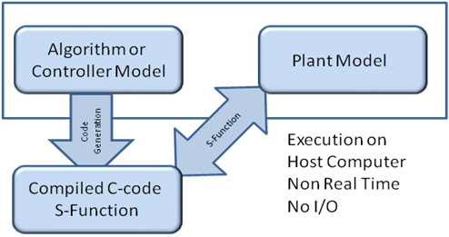
SiL (Software in the Loop)
Test object: generated code
Environment is simulated
The inputs and outputs of the test object are connected to the test system.
The generated code is executed on a PC or on an evaluation board.
Automatic test execution through:
The used development environment (e.g:MATLAB/Simulink with Realtime Workshop)
Interfaces to external tools

Slide 4
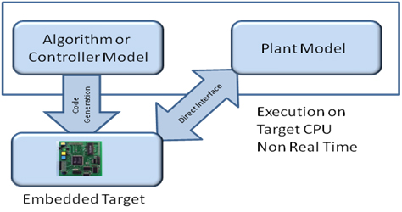
PIL (Processor in the loop)
Mathematic model is running in real-time
Control system is running on the target hardware platform
No input/output devices are used, a data connection is used to exchange data between the control system and the model
Intended for testing the computing power of the target hardware platform and testing the control system by simulating machine malfunction

Slide 5
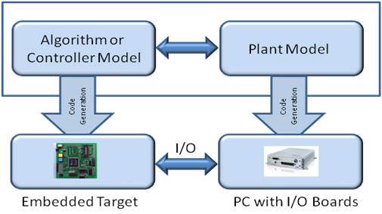
HiL (Hardware in the Loop)
Test object: real ECU
Environment simulation through environment models (e.g.: MATLAB/Simulink)
Inputs and Outputs are connected to the HiL-Simulator
Stimuli is generated by the HiL-Simulator
Comparison of the ECU output values to the expected values
Automatic test executionthrough the control software of the HiL-Simulator

Slide 6
Overview FlexRay
FlexRay: A Communication Protocol in distributed systems within automotive context.
Developed by the FlexRay consortium (BMW, DaimlerChrysler, Mo-torola, Philips) founded in 1999.
Since 1999 many well-known companies joined (e.g. Bosch, GM,VW, Mazda, etc.)
aim: fast, flexible, fault-tolerant communication protocol.
FlexRay was used for the first time in BMW X5 model in 2007.

Slide 7
Why FlexRay ?
X-by-wire Technique
steer-by-wire, brake-by-wire....
Hydraulic steering and braking is replaced by an electronic system of sensors and actuators.
10Mbps x 2 bandwidth
Time-triggered for real-time transmission
Event-triggered for low-priority data
Synchronous
Deterministic system design

Slide 8
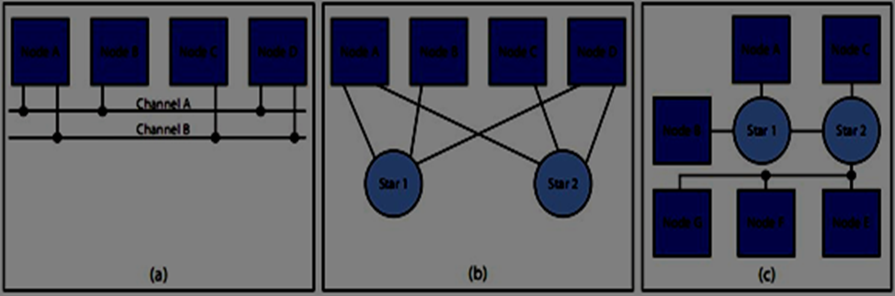
Network Topology
Figure 1: Some possible FlexRay Network topologies (a) Passive bus. (b) Active star. (c) Hybrid topology

Slide 9
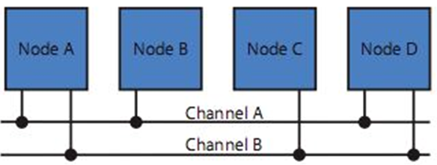
Passive Bus Topology
A node can be connected to one or both channels A and B
Figure 2: Passive Bus Topology

Slide 10
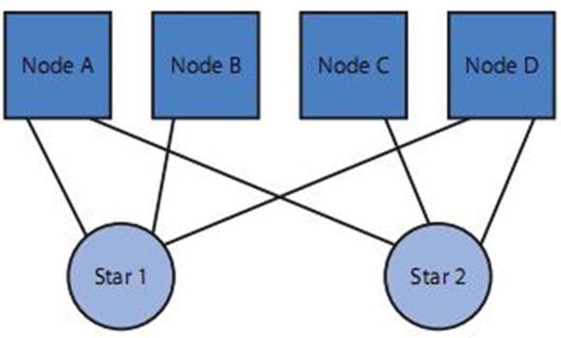
Active Star Topology
Figure 3: Active Star Topology
Free of closed rings.
- Received Signal is driven to all connected nodes.
- A node could be connected to a maximum of two star couplers

Slide 11
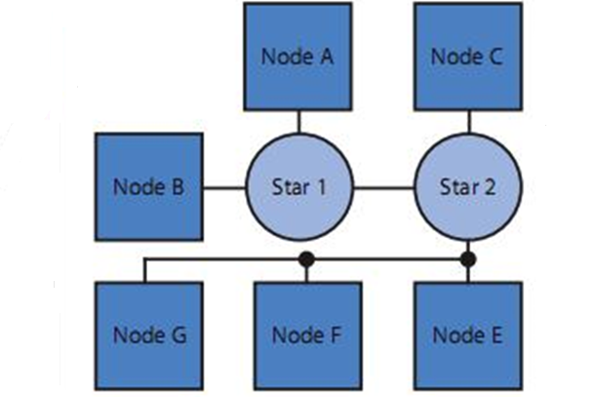
Hybrid Topology
Figure 4: Hybrid Topology

Slide 12
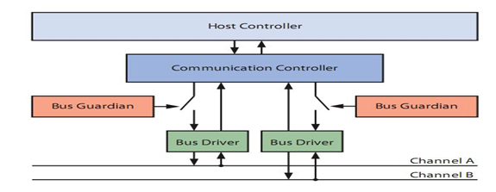
Structure of a FlexRay Node
Figure 5: Structure of a FlexRay Node

Slide 13
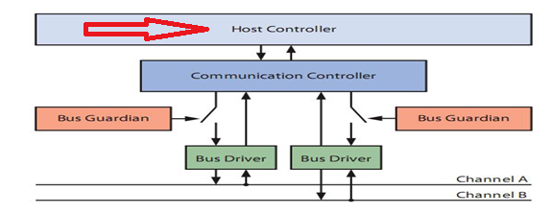
FlexRay Node: Host Controller
Ealizes all functions of the FlexRay protocol.
Receives data that should be sent from the host controller.
Decides what to do, and what to be sent to the communication controller.
Handles the data according to the FlexRay protocol, and sends them to the bus driver.

Slide 14
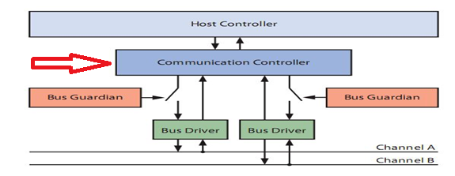
FlexRay Node: Communication Controller
Ealizes all functions of the FlexRay protocol.
Receives data that should be sent from the host controller.
Decides what to do, and what to be sent to the communication controller.
Handles the data according to the FlexRay protocol, and sends them to the bus driver

Slide 15
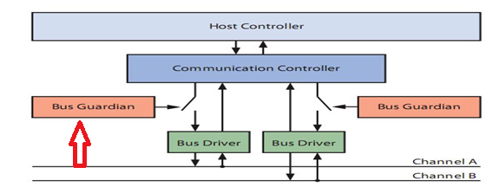
FlexRay Node: Bus Guardian
Changes in the supply of a node could occur.
This could cause defects on the bus.
Important for the fault-tolerance of the FlexRay.
Bus guardian could prevent these defects.
It organizes sending the data on the bus.
It prevents the node from sending and re-ceiving outside its time slots.
It can Recognize synchronization and com-munication errors

Slide 16
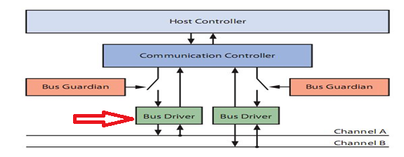
FlexRay Node: Bus Driver
Responsible for the connection between the FlexRay nodes and the bus.
Sends Data to the Bus.
Receives Data from the Bus

Slide 17
Frame Format
The frame format for data transmission contains three sections:
The header section: The header contains protocol control information like the synchronization frame flag, the frame ID, a null frame indicator and the frame length and a cycle counter.
The payload section: The payload section contains up to 254 bytes of data. In case the payload does not contain any data, the null frame indicator is set. A null frame is thus a valid frame that does not contain any payload data. It can however serve as an alive signal or can be used for clock synchronization purposes
Trailer section: The trailer section contains a 24 bit CRC that protects the complete frame.

Slide 18
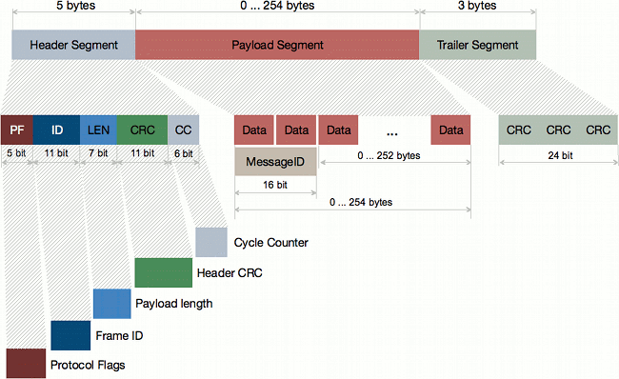
FlexRay Frame Format

Slide 19
The protocol flags contain five bits with the following definition
Reserved bit: reserved for future use. Sent as zero.
Payload preamble indicator: for a static frame this flag indicates the presence of a network management vector in the payload. For a dynamic frame this flag indicates the presence of a message ID in the payload.
Nullframe indicator: A zero indicates that the payload contains no valid data, a one indicates valid data in the payload.
Sync frame indicator: A one indicates that this frame is a sync frame for clock synchronization.
Startup frame indicator: A one indicates that this frame is a startup frame.

Slide 20
Automotive FlexRay™ Transceivers
TLE9221SX: Infineon's first FlexRay Transceiver
Link:http://www.infineon.com/cms/en/product/interface/automotive-transceiver/automotive-flexray-transceivers/channel.html?channel=db3a304333b8a7ca0133da166c22227b
The NCV7381 Evaluation Kit is a Reference Design for FlexRay™ transceiver designed consisting from a two stand-alone 2 channel FlexRay™ nodes.
Link:http://www.onsemi.com/PowerSolutions/evalBoard.do?id=NCV73810V2GEVB
NCV7381GEVK: Clamp 30 FlexRay™ Evaluation Kit
Link: http://www.onsemi.com/PowerSolutions/evalBoard.do?id=NCV7381GEVK
Link: http://www.etas.com/en/products/es920_flexray_module.php

Slide 21
General Background
FlexRay
10Mbps x 2 bandwidth
Time-triggered for real-time transmission
Event-triggered for low-priority data
Synchronous
Deterministic system design
Controller Area Network(CAN)
Bandwidth up to 1Mbps
Contention resolved by priority.
Asynchronous
Acknowledgment and retransmission when message is corrupted

Slide 22
Summary-Conclusion
FlexRay focuses on a set of core needs for todays automotive indus-try.
Higher data rates than previous standards.
Very flexible network topology.
Fault-tolerant operation.
FlexRay thus delivers the speed and reliability required for next-generation in-car control systems.

